Slide 1
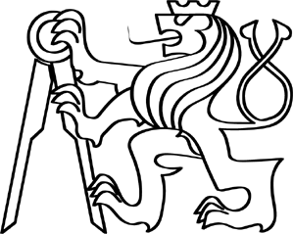
Making transition from 2D
Czech Technical university in Prague
Faculty of Electric Engineering
2010
Martin Lukeš

Slide 2

Organisation – main points
Möbius strip
Two dimensions
Three Dimensions
Tesseract

Slide 3
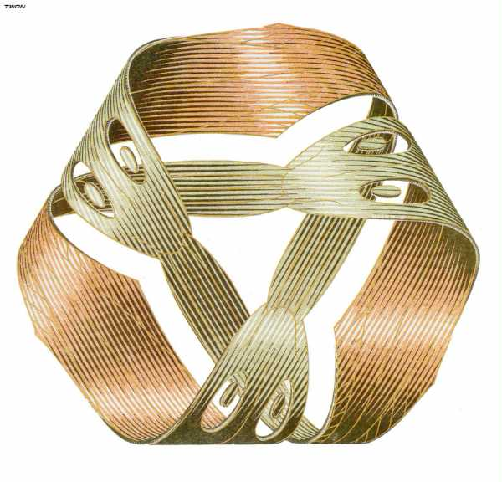

Möbius strip
surface with only one side and only one boundary component
math model - easy created from paper by half twist and joining the ends of the strip together

Slide 4

Most known Möbius strip

Slide 5
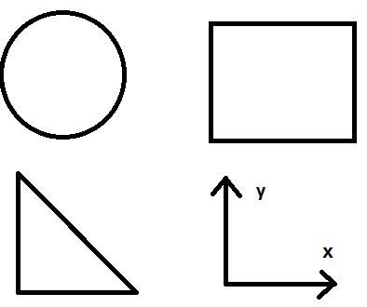

2 dimensions
circle, rectangle, triangle...
2 dimensions:
length + width
y & x axis

Slide 6

3 dimensions
3 axis (x, y, z)
Real world
Length, width, height

Slide 7
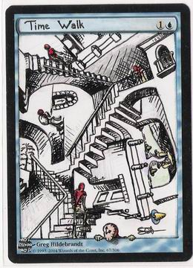
3 dimensions

Slide 8
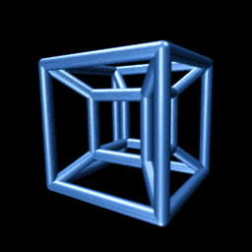
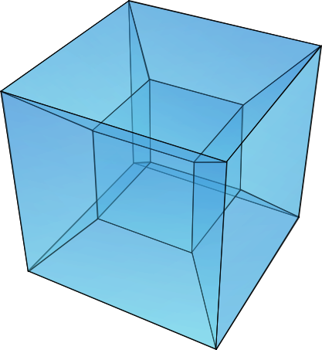
Tesseract

Slide 9
Summary
Möbius Stripe
Tesseract – 4 dimensional cube
2D + 3D

Slide 10
Thanks for your attention – time for questions
Related links:
http://en.wikipedia.org/wiki/Mobius_strip
http://forums.starcitygames.com/viewtopic.php?t=293409&start=0
Martin Lukeš

